Slide 1
Eragon Project Mid-evaluation

Slide 2
Overview
We have implemented the work in the paper “Digging Into Self-Supervised Monocular Depth Estimation”.
The goal is to automatically infer a dense depth image from a single color image.
The paper proposes three architectural and loss innovations.
A novel appearance matching loss to address the problem of occluded pixels that occur when using monocular supervision.
A novel and simple automasking approach to ignore pixels where no relative camera motion is observed in monocular training.
A multi-scale appearance matching loss that performs all image sampling at the input resolution, leading to a reduction in depth artifacts.

Slide 3
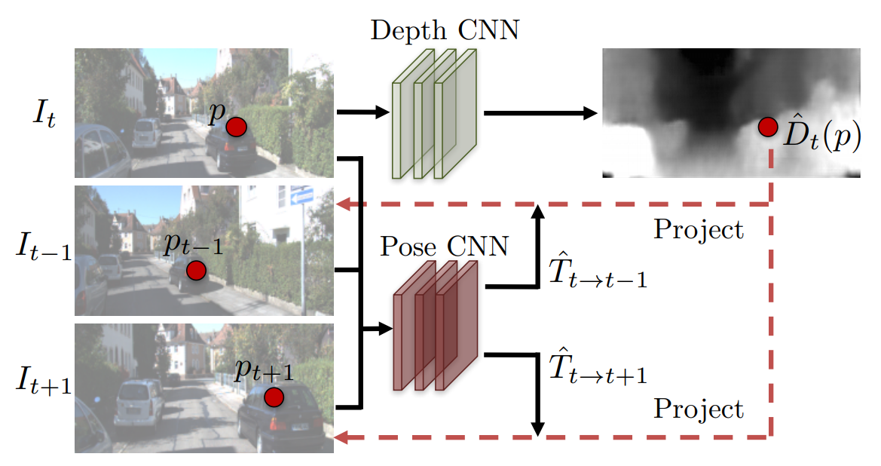
Overview
Figure: Unsupervised Learning of Depth and Ego-Motion from Video, CVPR 2017

Slide 4
Method
Depth & pose network: The depth estimation network is based on the U-Net architecture, i.e. an encoder-decoder network with skip connections.
For Pose estimation, we use a seperate network to predict the pose between a pair of frames. We predict the rotation using an axis-angle representation.
Per-pixel minimum reprojection: When correspondences are good, the reprojection loss should be low. However, occlusions and disocclusions result in pixels from the current time step not appearing in both the previous and next frames. The baseline average loss forces the network to match occluded pixels, whereas the minimum reprojection loss only matches each pixel to the view in which it is visible, leading to sharper results.
Full-resolution multi-scale: We upsample depth predictions at intermediate layers and compute all losses at the input resolution, reducing texture-copy artifacts.

Slide 5
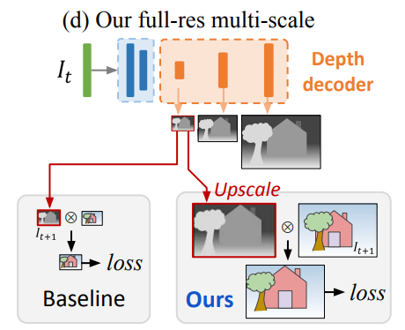
Depth and Pose Network
Both the Depth decoder and Pose CNN use ResNet encoder to perform feature extraction on the Input image(s).
The default encoder is set to be Resnet-18, pretrained on ImageNet.
The Depth decoder predicts the depth maps at various scales which are upscaled to original resolution, before warping to the target frames and generating the corresponding rgb images to compute photometric reconstruction loss and generate supervision.
Figure: Digging Into Self-Supervised Monocular Depth Estimation, ICCV 2019

Slide 6
Photometric reconstruction loss
The depth map predicted for the src frame is used to generate a point cloud which is then warped using the transformation matrix T_{t-t’} ,predicted by pose network, and then reprojected on the image plane to get the depth map for the target frame.
p_{t’} = KT_{t-t’}D_{t}(p_{t})K⁻¹p_{t}
p_{t} is the image coordinate of point t w.r.t src camera frame.
p_{t’} is the image coordinate of point t w.r.t target camera frame.
K is the camera matrix.
D(p_{t}) is the depth of the point t.
This map is then used to sample pixel values (rgb) using bilinear interpolation from the src frame to generate the target rgb frame.

Slide 7
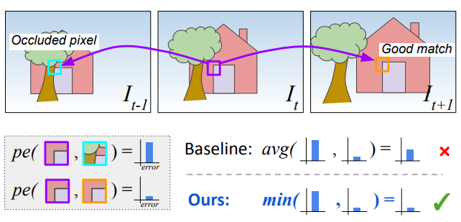
Photometric reconstruction loss
The difference is between the predicted target frame and ground truth is used as supervision and is generated using the following loss fn:
L(pred, gt) = α(1 − SSIM(pred, gt))/2 + (1 − α)||pred − gt||¹,
which is essentially a weighted sum of SSIM and L1 Loss.
Now to handle cases of occlusions / disocclusions, we take the minimum of the two cases (t -> t-1) and (t -> t+1), since this shows empirically better results.
Figure: Digging Into Self-Supervised Monocular Depth Estimation, ICCV 2019

Slide 8
Photometric reconstruction loss
Also, to account for cases where there is no relative motion (either camera is stationary or objects are moving in the same way), the loss term is multiplied with a mask.
This mask can either be predicted using another network or can be computed as a binary mask using the following heuristic:
µ = [min(pe(target, pred)) < min(pe(target, src))]
Set µ to only include the loss of pixels where the reprojection error of the warped image is lower than that of the original, unwarped source image. This will simply exclude pixels that are stationary or in textureless regions.

Slide 9
Experiments
Default setup
Use Resnet-50 instead of Resnet-18 for feature extraction in encoder.
Disable auto-masking and use predictive mask instead.
Disable depth prediction at multiple scales
Remove SSIM component in computation of reprojection loss.

Slide 10
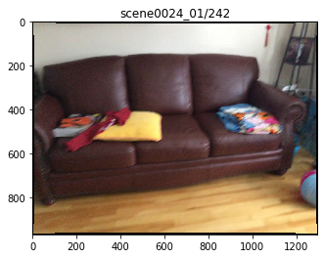
Results

Slide 11
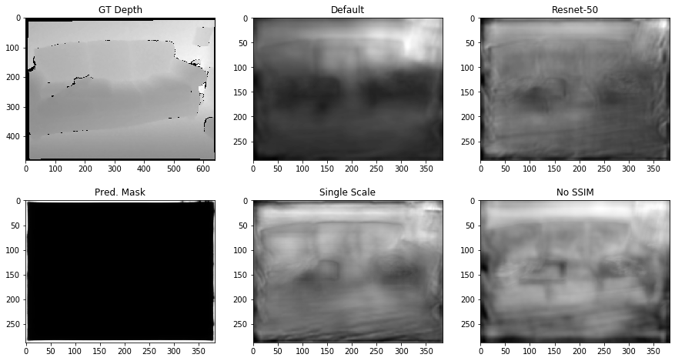
Results

Slide 12
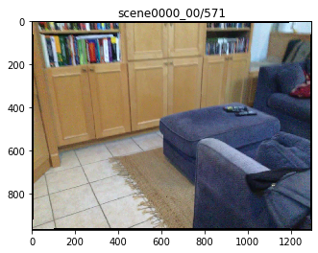
Results

Slide 13
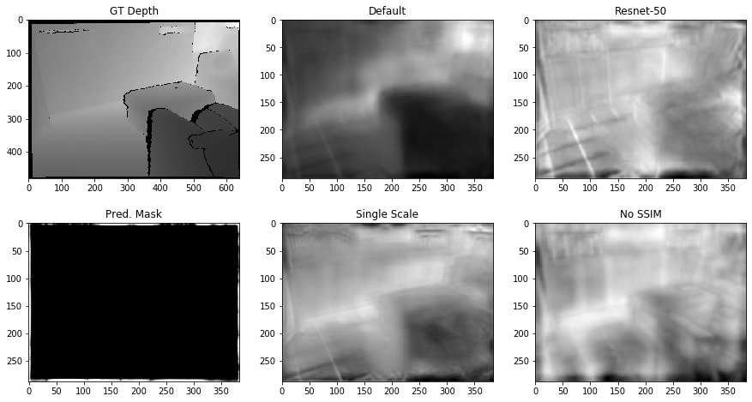
Results

Slide 14
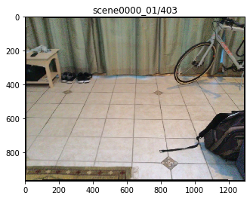
Results

Slide 15
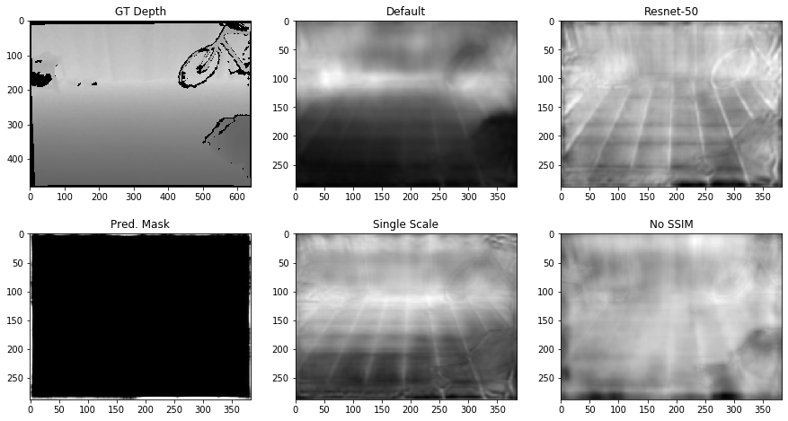
Results

Slide 16
Conclusion
From the results, we can infer the following qualitatively:
The default parameters performs the best amongst all the models.
Using ResNet-50 improves the details captured in the depth map but doesn’t improve the depth prediction itself.
Using predictive mask instead of automasking simply leads to collapse of depth decoder.
Using single scale or no-ssim loss function leads to noisy estimates.
Also, for all the models, it can be seen that:
Depth prediction for textureless regions like floor, cabinet isn’t consistent w.r.t planarity.
Depth prediction isn’t able to maintain the boundaries properly.

Slide 17
Future work
Based on the issues mentioned in the conclusion, it is evident that the current methods aren’t enough to get good results for indoor environments that have a lot of planar surfaces which tend to be textureless.
To solve the above issues, we will use the techniques provided by the IndoorSFM Learner, namely:
Compute loss only on distinct keypoints extracted using an algorithm like ORB, SIFT. This will ensure that the network doesn’t get confused by points in the textureless regions which lead to non-sharp boundaries.
Enforce planarity constraint on the depth prediction for textureless regions by grouping them using superpixels and estimating the plane parameters to fit the same.

